Slide 1

GJK
Game 256

Slide 2
GJK
Gilbert-Johnson-Keerthi distance algorithm
Determines minimum distance between two convex shapes

Slide 3
GJK Pseudocode

Slide 4
Elements of GJK
Minkowski Sum
Support Function
Simplices

Slide 5


Minkowski Sum
The Minkowski Sum is defined as:
$A+B$

Slide 6
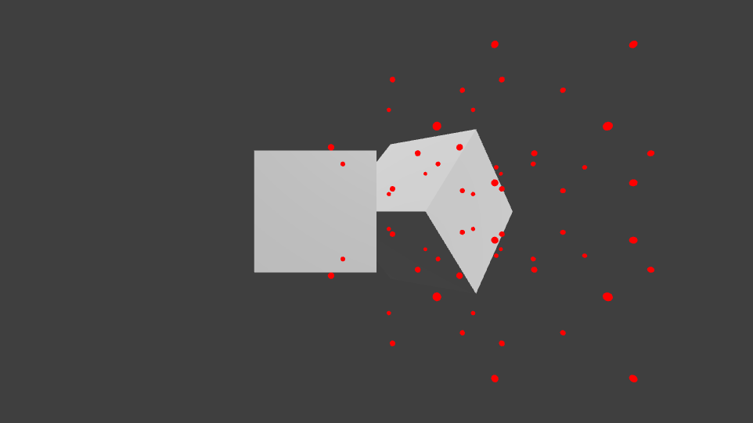

Minkowski Sum
GJK uses $A+(−B)$ instead of $A+B$.
$A+(−B)$ for the previous cubes:

Slide 7
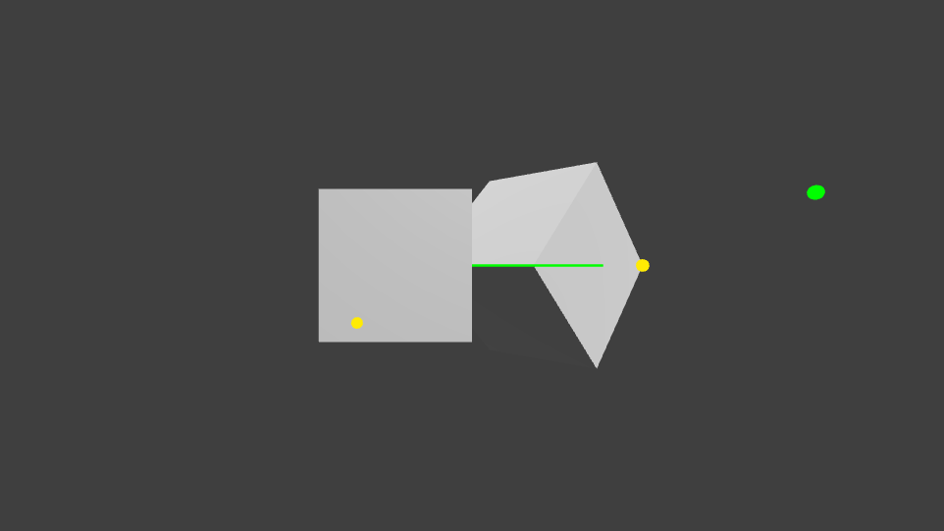
Support Point
Support Points exist on the Minkowski Sum
They are used to generate simplices.

Slide 8
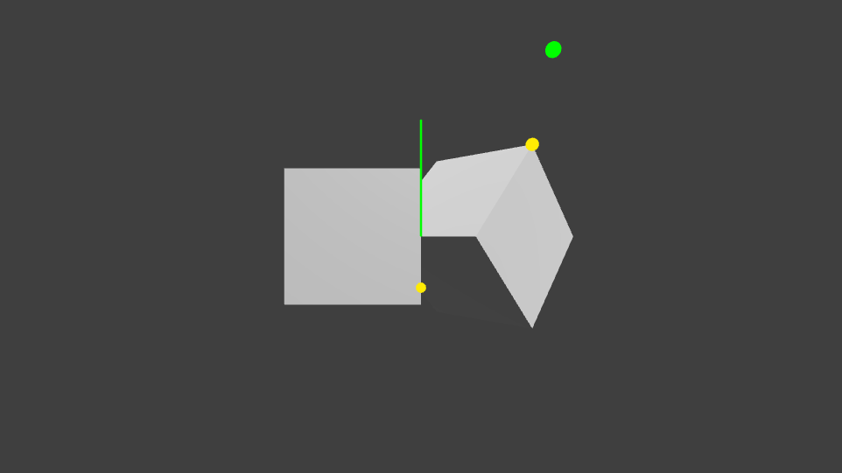

Support Function
The Support Function finds the correct point on the Minkowski sum, given $A$, $B$, and a direction.

Slide 9
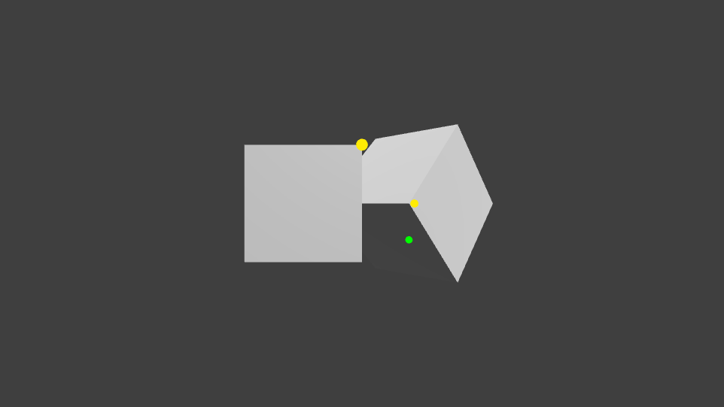
Support Point
A.FurthestPoint(direction) +
(-B.FurthestPoint(direction))

Slide 10
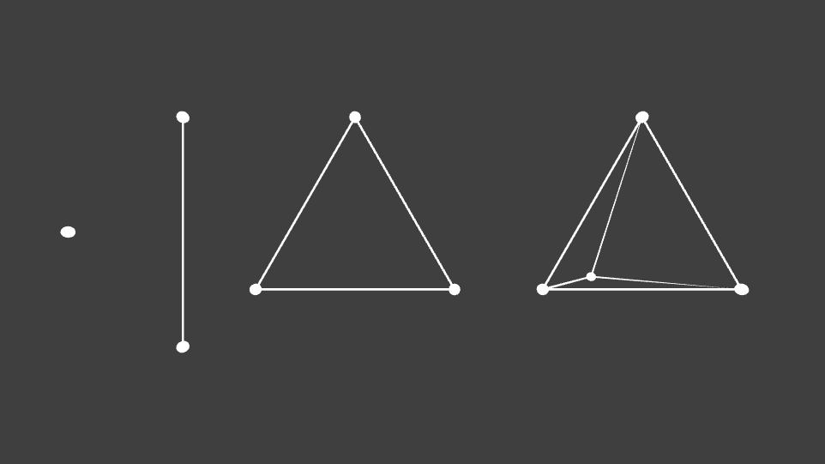
Simplex
A simplex is a simple geometric shape.
We test for origin containment, in GJK.

Slide 11

Recap
Modified Minkowski Sum: $A+\left(−B\right)$
Support Point: Support(shape A, shape B, direction d)
  return A.FurthestPoint(d) + (-B.FurthestPoint(-d))

Slide 12
Up Next
Simplex

Slide 13
Fin

